Slide 1
Annual Report analysis

Slide 2
Agenda
Second level
Third level
Fourth level
Fifth level

Slide 3
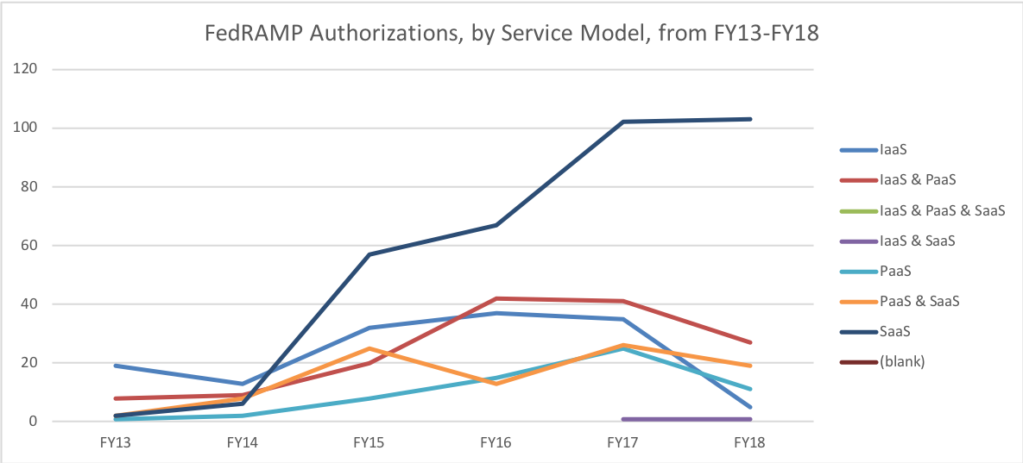
Authorization by Service Model - by year

Slide 4
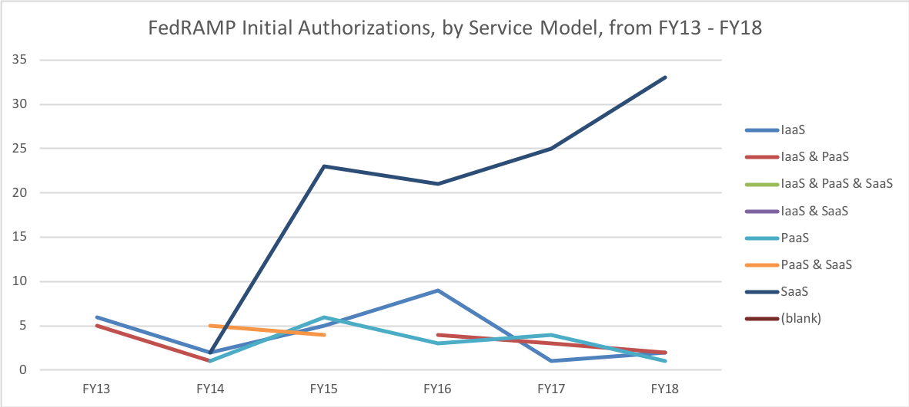
Authorization by Service Model - by year

Slide 5
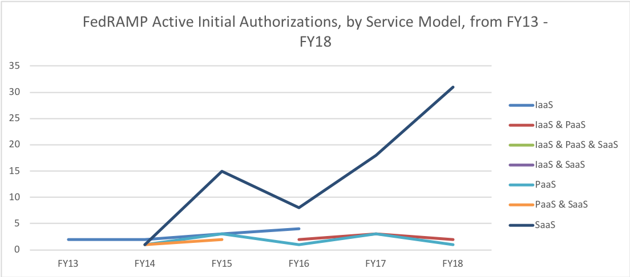
Authorization by Service Model - by year

Slide 6
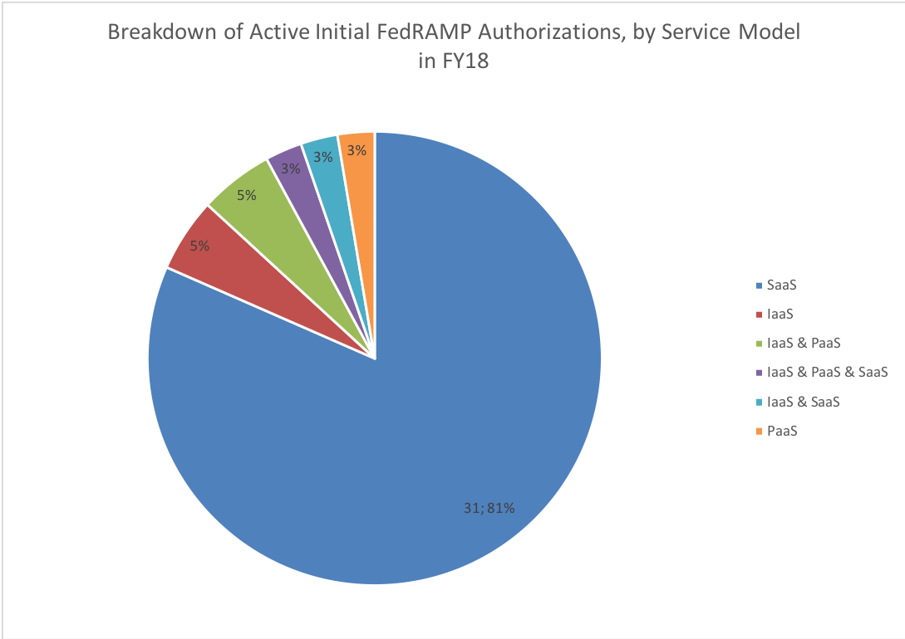
Authorization by Service Model – 2018 - Percentage pie chart

Slide 7
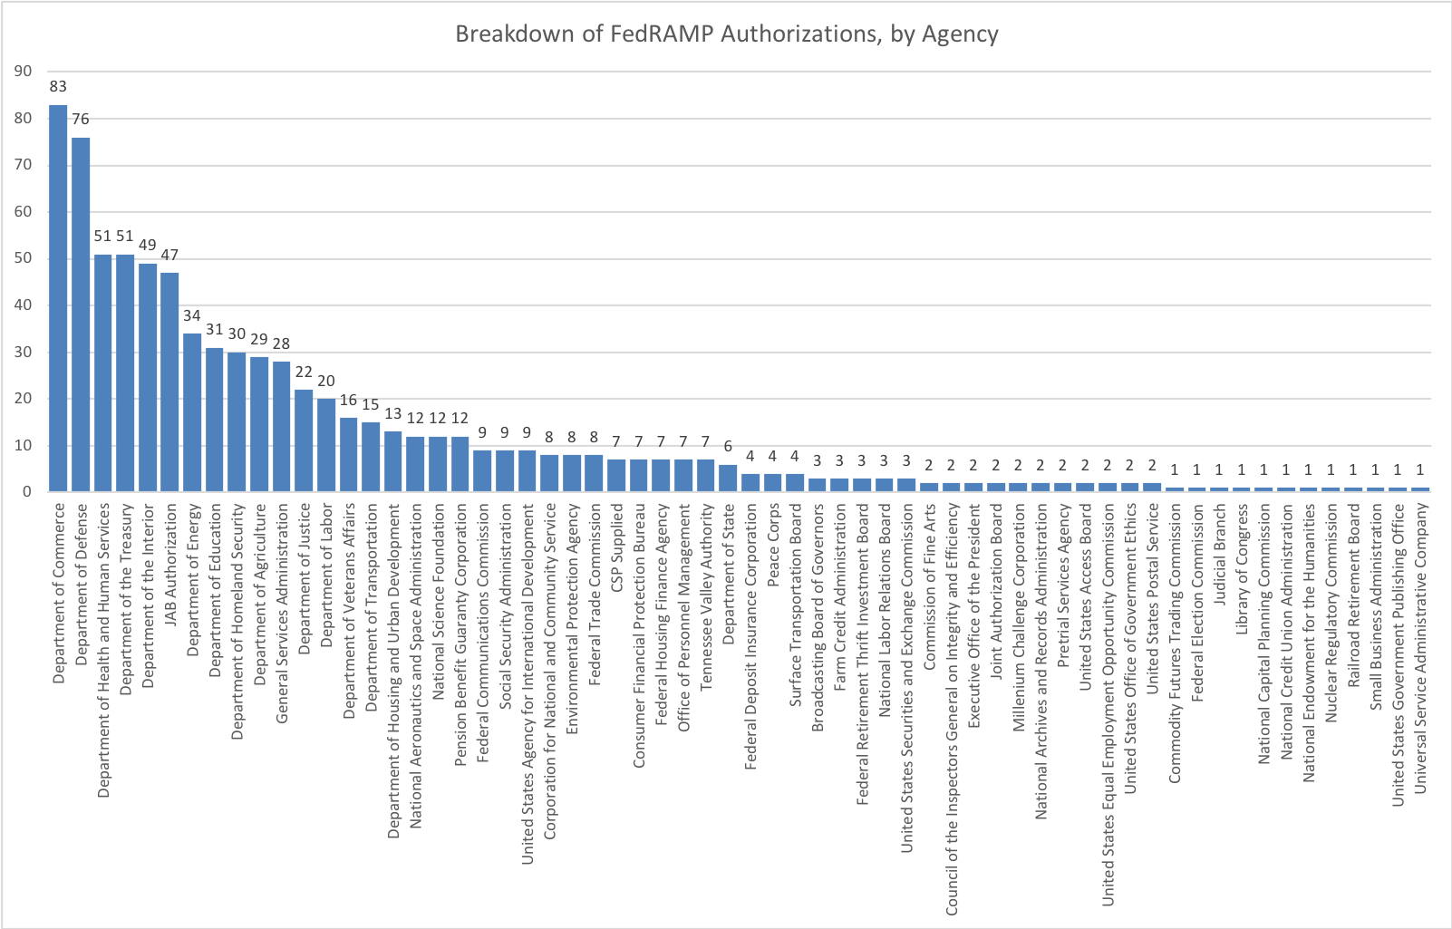
Authorization by aGENCY

Slide 8
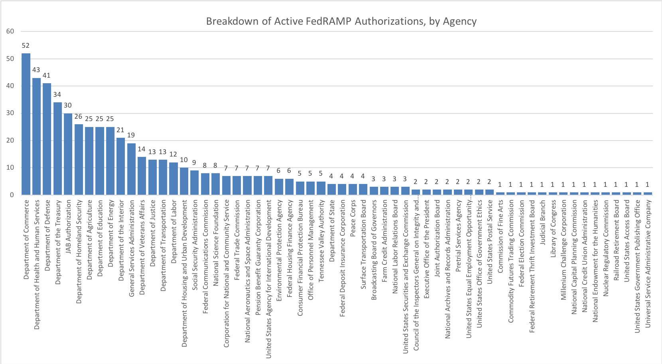
Authorization by aGENCY

Slide 9
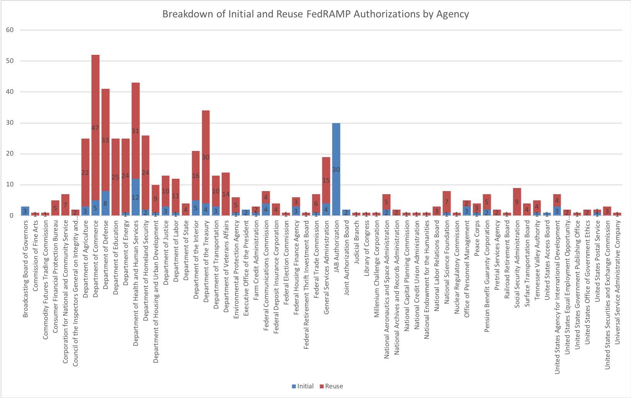
Authorization by aGENCY

Slide 10
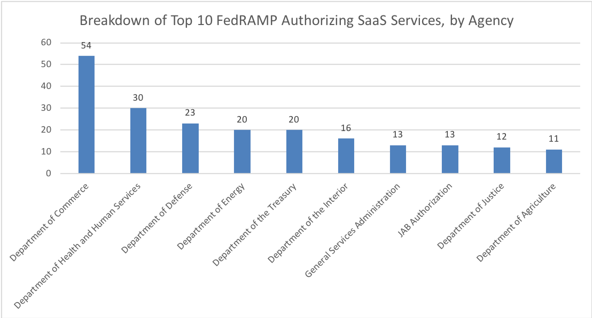
tOP 10 – Agencies authorizing sAAS Services

Slide 11
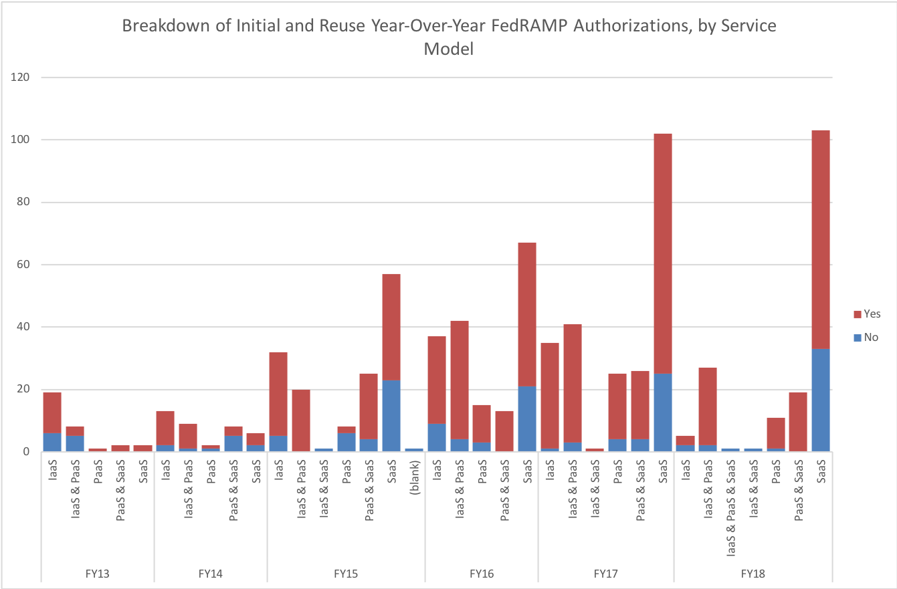
Increase in REUSE YEAR-OVER-YEAR (YOY)

Slide 12
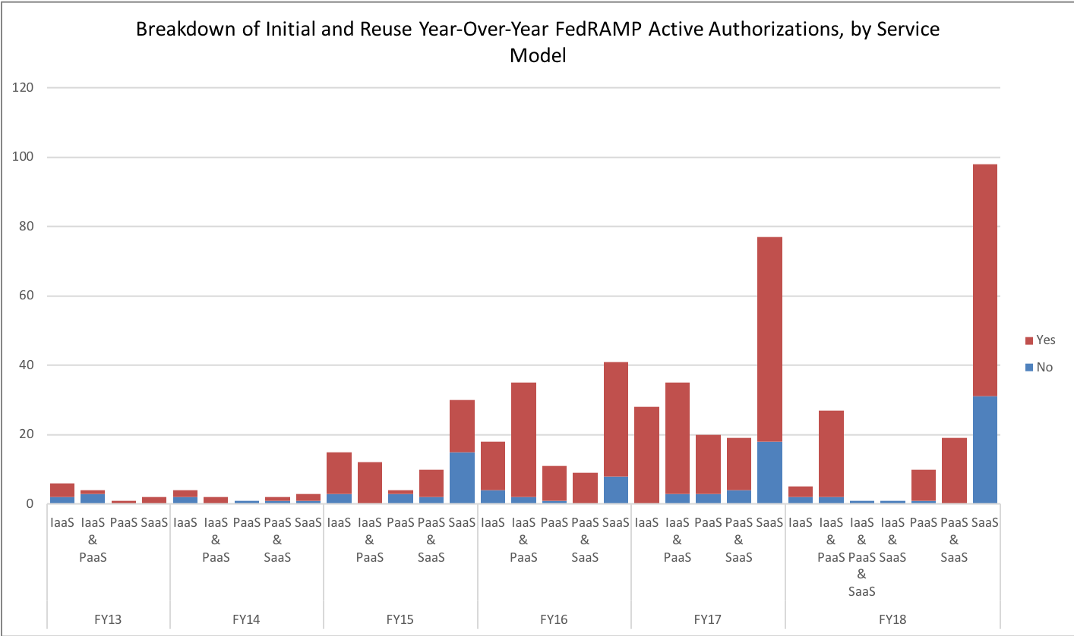
Increase in REUSE YEAR-OVER-YEAR (YOY)

